Slide 1
Domain #5 Capstone Project Video Analysis and Event recognition
Group 5
RAJEEV KUMAR 2020AIML004
JAYDEEP GHOSE 2020AIML016
SAI SATYA CHANDRA EDARA 2020AIML063
NANDA K KARANAM 2019AIML044

Slide 2
Table of Contents
Objective
Problem Statement
Business Benefits and applications
Detailed Plan of Work
Project Activity
You tube video download and feature extraction in frames and understanding concepts and folder configuration
Video to frame extraction
Frame extraction and saving output files
Creating test and train dataset
Jupyter file demonstration

Slide 3
OBJECTIVE
The objective of the action recognition systems is to classify each video into the class that represents the action that happens in the video.
In recent years, automatic human activity recognition and event detection have drawn much attention in the field of video analysis technology due to the growing demands from many applications, such as surveillance environments, entertainment environments and healthcare systems.
Large amount of video in surveillance systems capable of processing video to automatically detect and recognize events. The main objective is the analysis of computer vision techniques and algorithms to predict automatic detection of specific events in video sequences

Slide 4
Problem Statement
Computer Vision systems deal with high variety and volume of data, specifically images or videos. As a result, these systems need intricate techniques to make sense of the data and then make data driven decisions.
The aim of this project is to create a model that can detect the basic events like swimming, jogging, soccer penally, basketball and boxing etc.
Given a video, is it possible to recognize the action being performed in that video by an automatic system? An action recognition system is built on basic steps: first, the input video or sequence of frames; second, the extraction of low-level features from the frames; and finally, mid-level pose/gesture or action descriptions from low-level features.
The model will be given a set of videos where in each video, a group of persons will be performing an action. The label of a video will be the action that is being performed in that video. The model will have to learn this relationship, and then it should be able to predict the label of an input (video) that it has never seen. Technically, the model would have to learn to differentiate between various events

Slide 5
Business Benefit and Applications
Automations
Operational effectiveness
Cost Reduction
Quality of output
CCTV live video capture

Slide 6
Business Benefits and applications cont..
E-commerce
Searching and advertising is one of the mostly used use case of image recognition in E-commerce industry. Image recognition powered by deep learning can provide us advance capabilities like personalized searches, customer analytics, social media and conversation commerce, etc. With the date they got from image recognition, businesses can find insights for campaigns and marketing strategies. It is also capable to find user’s sentiments and expressions. This data will help marketers getting more return on their investments.
2. Social Media
Social media is also getting enormous benefits from image recognition. Facebook is one of the best examples of it. Facebook’s image recognition can recognize your family members and friends, identify their names and will give you suggestion to tag them while you upload picture with them. Many other social media platforms like LinkedIn & Twitter also use image recognition and object recognition features. Image recognition in social media make searches easy and effective.

Slide 7
Business Benefits-cont..
3. Surveillance and Security
In surveillance and security industry, image recognition has many applications. Many big companies and security department use facial recognition to ensure security and identify crime. This process includes scanning of almost million images and adding them into deep neural networks. Then the system analyzes the images and compare them to suspects. In many cases it has proven to be very successful & effective and helped solving crimes.
4. Healthcare monitoring applications
Basically, healthcare monitoring systems are designed based on the combination of one or more AR components such as fall detection, human tracking, security alarm and cognitive assistance components. Most of the healthcare systems use body-worn and contextual sensors that are placed on patients’ bodies and in their environment. Once help is needed, the system notifies the relevant parties (i.e. medical personnel) about the situation to assist the patient quickly. The E-safe fall detection and notification system27 has used the zigbee-based wearable sensor system to automatically detect fall situations and notify the in-house correspondents via zigbee technology.
5. Gaming
Other than these industries, there are many sectors which are taking leverages of Image recognition and computer vision. Image recognition has several powerful applications that create a great deal. What do you think about this technology and what are the use case which you would like to cover with image recognition? Tell us your viewpoint and let us help you out with your requirements. From identifying requirements to delivering best machine learning model, Kevit can bring you all the benefits that come with these technologies within your business.

Slide 8
Detailed Plan of work
Week 01
Week 03
Introduction
Understanding the problem statement
Understanding the business benefits
Environment Setup
Planning the tasks
Discussion with team members
Review with mentor
Repository creation in GitHub and google Colab
Creation of Video and Frame folders
Creation of Training and Test datasets
Discussion with team members(Code Review)
Review with mentor
Further Plan to be finalized
Downloading video from you tube from python
Folder manipulation
Extraction of video frames
Discussion with team members(Code Review)
Review with mentor
Merging of code
Finetuning and testing code
Preparation for mid-review (PPT/Code Review)
Review with mentor
Further Plan to be finalized
Week 02
Week 04

Slide 9
Tentative Upcoming Plan of work
Week 05
Week 07
Add Feedback from last review
Image feature extraction – Sizing, Normalizing, Converting to numpy array
Extracting Feature using pre-trained weights on ImageNet (VGG16)
Review with mentor
Create custom CNN model
Train and Test model
Compare against VGG Model
Plot Model Accuracy and Loss
Review with mentor
Create Keras Sequential Model
Save model for reuse
Test Model with unlabeled video
Start building the report
Review with mentor
Create Web application
Finetuning and testing code
Preparation of final PPT and report
Review with mentor
Week 06
Week 08

Slide 10
Select Given Video Dataset
Demonstrate Code in Python Jupyter Files
Make a Root Directory
Convert Video Files to Video Frame
Create Folder Structure to Store frames
Create Train and Test Folders
[Further processing as per upcoming plan]
[Further processing as per upcoming plan]
Creation of Github repository
Testing and syncing in local
Testing in google collab
Final output [Once We achieve progress till week 8]
Model creation and Event Detection in Videos

Slide 11
Project Resources
Sr No | Phase | Resource Type | Resource | Versions if Applicable
1 | All | People | Mentor, Faculty, TA
2 | All | Hardware / Laptop | 16GB RAM, Windows 10, Intel Core i7
3 | All | Software | Jupyter Notebook Anaconda Python CV2 | 6.1.4 4.8.3 3.8.5 4.3.0
4 | Collaboration | Software | Google Meet GitHub repository creation WhatsApp Google Colab | https://github.com/eiensatya7/cap4_group7_va https://colab.research.google.com/notebooks

Slide 12
THANK YOU

Slide 13
Mid Review Feedback Incorporation
Feedback | Implementation
Explore OCR Tools | PyTesseract and EasyOCR
Noise Reduction | Explore preprocessing of audio(dbFS)
Explore Object Detection Tools | YOLO v3, YOLO v4 & ImageAI
Multiple Combination of Input image size and color | Extracted text from Images for different combinations

Slide 14
Detailed Plan of work
Week 01
Week 03
Week 05
Week 07
Introduction
Understanding the problem statement
Understanding the business benefits
Environment Setup
Planning the tasks
Discussion with team members
Review with mentor
Incorporate mentor review feedback
Handling multiple videos
Convert to Gray and Scaled Images
Discussion with team members(Code Review)
Review with mentor
Incorporate mid-review feedback
Continuation with EasyOCR
Sequencing of audio and image frames
Data cleansing
Discussion with team members
Review with mentor
Incorporate mentor review feedback
Object detection in Ads with difference in Yolo3 and Yolo4 output
Model Evaluation & Interpretation
Discussion with team members
Review with mentor
Incorporate mentor review feedback
Folder manipulation
Extraction of video frames
Discussion with team members(Code Review)
Review with mentor
Incorporate mentor review feedback
Extraction of Audio and preprocess
Started with OCR and text extraction from images
Preparation for mid-review (PPT/Code Review)
Review with mentor
Incorporate mentor review feedback
Processed data to csv
Modelling and object detection, classification model
Discussion with team members
Object detection with Yolo3,Yolo4,ImageAI
Review with mentor
Incorporate mentor review feedback
Report Writing
Preparation & submission of Solution
Review of solution
Viva Voce
Week 02
Week 04
Week 08
Week 06

Slide 15
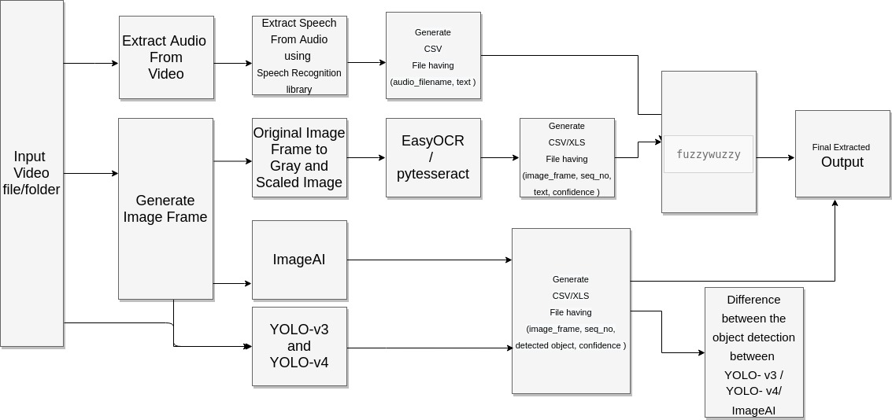
Architecture Diagram

Slide 16
Project Setup Demo

Slide 17
Machine Learning Modelling & Techniques Applied
Tools | Objective | Techniques
EasyOCR | Image to Text | LSTM , ResNet , CTC
IBM Watson | Audio to Text | LSTM
Google Speech to Text | Audio to Text | LSTM
CV2-YOLOv3 | Object Detection | CNN , YOLOv3 ,Transfer Learning
CV2-YOLOv4 | Object Detection | CNN , YOLOv4, Transfer Learning
ImageAI | Object Detection | CNN , ResNet
Fuzzywuzzy | Tagline/Headline Matching | Levenshtein Distance

Slide 18
Audio to Text – Sample Output
IBM-WATSON
Video | AudioText
2-VDO-OblectDetectionDetection | working hard to lower your LDL bad cholesterol . making enough progress . well take the highest dose that you can but still aren't getting where you need to be . now there's were passed a different way to reduce LDL get on the path to dramatically lower numbers . how the works differently than your staff to help clear LTO . a plus the highest dose that broke down L. B. L. an average of 71 percent more than a stand alone . do not take your path if you are allergic to . have to make calls allergic reaction . I think . severe rash swollen face when trouble breathing . and side effects include runny nose sore throat common cold symptoms flu or flu like symptoms . and redness pain or bruising at the injection . added to a highest dose that pass along with L. the au blows up to 90 percent of people asking for a password . the way lower LDL .
VDO-AD-105 | this is electricity . this is the power plant . this is Tim barcode . that's me . something he's researching at Exxon Mobil you think you'll sell to capture carbon emissions a power plant . this is the potential repeating CO 2 emissions by up to 90 percent . while also producing more power . this could be big energy lives here .
VDO-AD-200 | and mammal is the strong white outer layer of your to surface the thing that's really important to dentist is to make sure that that enamel things strong and resilient for a lifetime the more that we can strengthen and re harden that to surface the wider their patients either going to be Dennis are going to really want to recommend her name was strong and bright it helps to strengthen and re hard in the enamel it also has a listing action it's going to give their patients the protection that they need and the wider see let's say one .
VDO-AD-900OblectDetection | one in . thank you thank you . I can't come . Jeff just confirm someone is always bringing a plus one . yeah . what's your dream yep we have you listed make it during your .

Slide 19
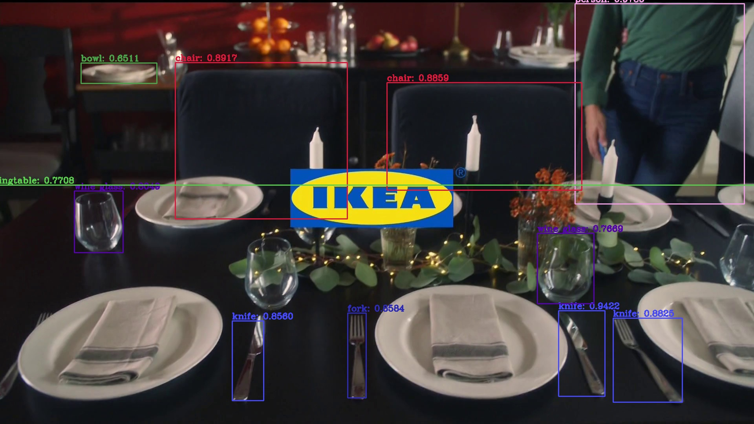
Object Detection

Slide 20
Object Detection Difference YOLOv3 - YOLOv4
For Video

Slide 21
Object Detection Difference YOLOv3 - YOLOv4
For Images

Slide 22
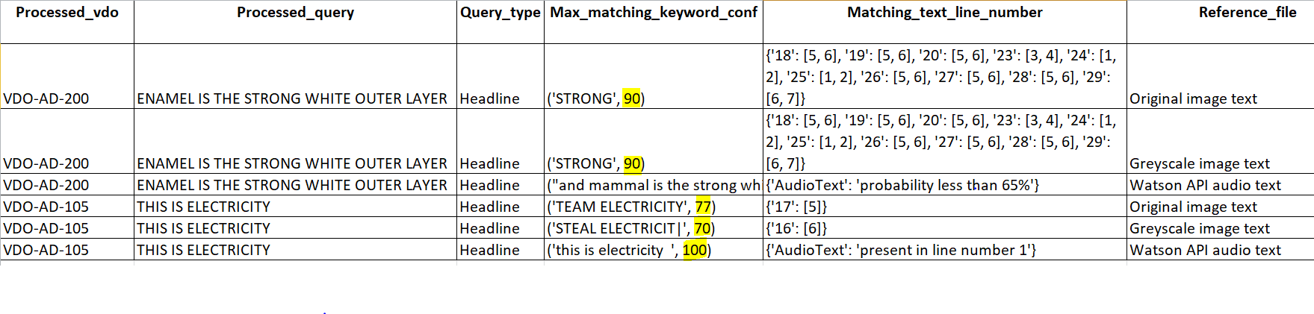
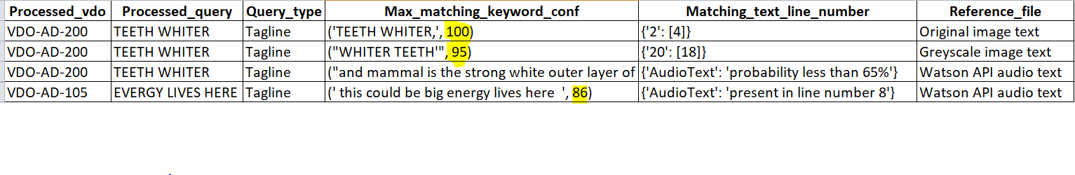
Headline-Tagline Search Result
Headline Matching Result
Tagline Matching Result

Slide 23
Conclusion and Recommendation
Using the outcome Ad Annotation tool, ads can be made more precise, in order to seek the user's attention which acts as a critical path for a product success. Tool will save time, resources, and money and will impact the organization's bottom line ROI.
We have proposed a tool which extracts various components of an advertisement video like images, objects, text and audio .
The tool will facilitate the brainstorming process of advertisers through a semantic thesaurus that includes video ad content annotations, as well as knowledge relating to ad concepts, product type and annotation terms.
Several research questions remain challenging for future work like, Video Advertisement Effectiveness, Label Discovery etc.

Slide 24
Future Scope
Audio noise Reduction: use noise reduction technique from deep learning )
Logo Detection :(Rule based , Logo can be present besides company name )
Design frontend video upload functionality and store videos and images at some cloud and visualization of 360view to video. ( with react and expose api for visualization)
Topic modelling
Sentiment Analysis
Object detection using GAN , CNN and encoder and decoder and other ( using Generative Adversarial Network )

